Slide 1

Tutorial: Histograms, Random Numbers
Dr Lee Barnby
School of Computing and Engineering
7MA505 Statistical Techniques
Week 2, Autumn Semester

Slide 2
Dataset definition, histogram creation
x <- c(121, 82, 100, 151, 68, 58, 95, 145, 64, 201, 101, 163, 84, 57, 139, 60, 78, 94, 119, 104, 110, 113, 118, 203, 62, 83, 67, 93, 92, 110, 25, 123, 70, 48, 95, 42)
  Can be copied and pasted into your R session (no need to type!)
xh <- hist(x)
  Create a histogram using the data stored in x
names(xh)
  Check the various histogram properties. Eg
  xh$counts # Counts per histogram bin
  xh$breaks # Check the breaks in histogram bins
  xh$counts/36 # Relative frequencies

Slide 3
Histogram plotting
This is a lower case letter ‘L’ not the number one
plot(1:10, xh$counts/36, type="l", main="Relative frequencies")
  Try changing things
plot(ecdf(x),verticals=TRUE, col.points="blue")
  ecdf() is the ‘empirical cumulative distribution function’
  Try the following:
  plot.ecdf(rnorm(1000), verticals=TRUE, col.points="blue")
  plot(ecdf(rnorm(1000)), verticals=TRUE, col.points="blue")
Change the histogram binning i.e the breaks

Slide 4
Histogram beautification
Ideally the histogram representing the data should make sense on its own
  Have an informative title (also for the axes)
  Have labelled axis
  Have sensible colours and symbols
  Etc.
Be saved to disk for future modification
Be saved as a picture for inclusion in a report, online etc.

Slide 5
Part 2 – Random numbers
rnorm() and runif() functions can generate random data
Generate values. (Say, 50 values.)
  Plot their histograms.
  Determine their means and standard deviations.
Repeat.
  Are the results roughly the same?
  More importantly, are the results identical?
E.g. sample1<-runif(6)
Repeat sample2 <- runif(6) , sample3 <- runif(6)
Are the same values each time?
  If not, why not?

Slide 6
Random numbers with seeds
Repeat, but doing the following prior to generating the values: set.seed(5413)

Slide 7
Built-in probability functions
Type the following
  pnorm(3, 0, 1)
  pnorm(2, 0, 1)
  pnorm(1, 0, 1)
  round(pnorm(1, 0, 1), 3)*100
  round(pnorm(2, 0, 1), 3)*100
  round(pnorm(3, 0, 1), 3)*100
  On the next slide correct output appears by each command (as a comment #)

Slide 8
Built-in probability functions
Type the following
  pnorm(3, 0, 1) # 0.9986501
  pnorm(2, 0, 1) # 0.9772499
  pnorm(1, 0, 1) # 0.8413447
  round(pnorm(1, 0, 1), 3)*100 # 84.1
  round(pnorm(2, 0, 1), 3)*100 # 97.7
  round(pnorm(3, 0, 1), 3)*100 # 99.9

Slide 9
Central Limit Theorem
To show that data, in this case sampled from a uniform distribution, approaches being normal as the sample size increases.
Try the following
  dice1 <- floor(runif(10000,1,7))
  hist(dice1)
Next, the use of further dice. Here is a simple way to do this.
  dice2 <- floor(runif(10000,1,7)) # Note: new random nos. generated each time.
  dice3 <- floor(runif(10000,1,7)))
  …
  dice10 <- floor(runif(10000,1,7))

Slide 10
Rolling the dice…
We want the average of the set of throws, each time there is a set of throws of the dice.
  hist((dice1+dice2)/2)
  hist((dice1+dice2+dice3+dice4+dice5+dice6+dice7+ dice8+dice9+dice10)/10)
What about
  hist(mean(dice1+dice2))

Slide 11
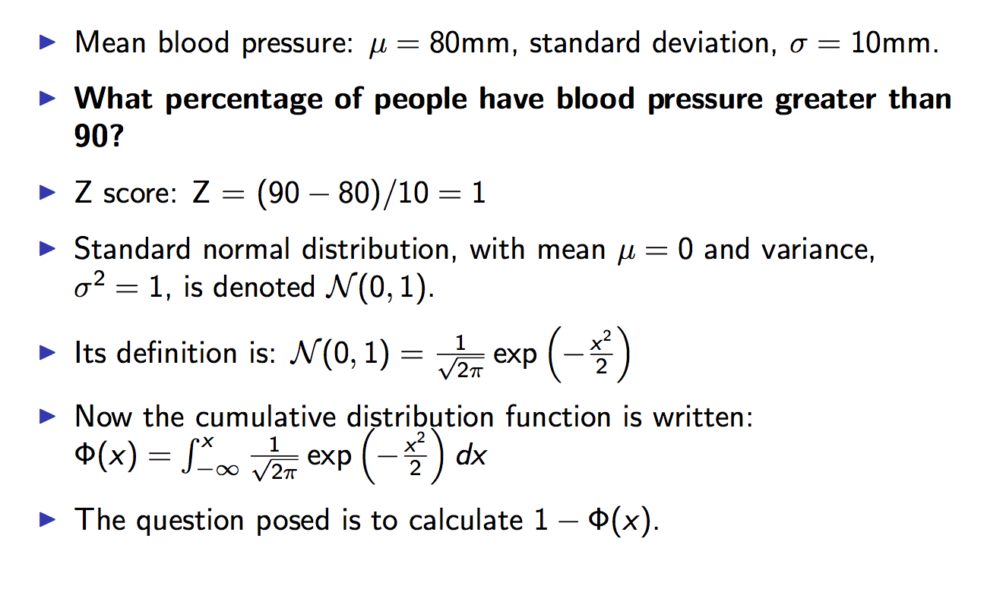
Example

